Slide 1
MACHINE LEARNING
IPL 1st Inning Score Prediction using Machine Learning
NALIN RAJ R 1NT18CS105
VIGNESH M 1NT18CS089
KUMARA H 1NT18CS081

Slide 2
ABSTRACT
Cricket is one of the most celebrated games in the world. With the introduction of machine learning techniques in the world of cricket, predicting the score of the match has been established as one of the most challenging problems. We will use some of these factors to predict score using machine learning algorithms. This Machine Learning model adapts a Regression Approach to predict the score of the First Inning of an IPL Match. Supervised machine learning is the construction of algorithms that are able to produce general patterns and hypotheses by using externally supplied instances to predict the fate of future instances. Supervised machine learning classification algorithms aim at categorizing data from prior information. Classification is carried out very frequently in data science problems
In the last decade a large number of supervised learning methods have been introduced in the field of the machine learning. Supervised learning became an area for a lot of research activity in machine learning. Many of the supervised learning techniques have found application in their processing and analyzing variety of data. One of the main characteristics is that the supervised learning has the ability of annotated training data. The so called labels are class labels in the classification process. There is a variety of algorithms that are used in the supervised learning method.

Slide 3
INTRODUCTION
The Dataset contains ball by ball information of the matches played between IPL Teams of Season 1 to 10, i.e. from 2008 to 2017. This Machine Learning model adapts a Regression Approach to predict the score of the First Inning of an IPL Match. Cricket is being played in many countries around the world. There are a lot of domestic and international cricket tournaments being held in many countries. The cricket game has various forms such as Test Matches, Twenty20 Internationals, Internationals one day, etc.
IPL is also one of them, and has great popularity among them. It's a twenty-20 cricket game league played to inspire young and talented players in India. The league was conducted annually in March, April or May and has a huge fan base among India. There are eight teams which represent eight cities which are chosen from an auction. These teams compete against each other for the trophy. The whole match depends on the luck for the team, player’s performance and lot more parameters that will be taken in to the consideration. The match that is played before the day is also will make a change in the prediction. The stakeholders are much more benefited due to the huge popularity and the huge presence of people at the venue. The accuracy of a data depends on the size of the data we take for analysing and the records that are taken for predicting the outcome.
Cricket is a game played between two teams comprising of 11 players in each team. The result is either a win, loss or a tie. However, sometimes due to bad weather conditions the game is also washed out as Cricket is a game which cannot be played in rain. A lot of times the result gets decided on the last ball of the match where the game gets really close. Considering all these unpredictable scenarios of this unpredictable game, there is a huge interest among the spectators to do some prediction either at the start of the game or during the game. Many spectators also play betting games to win money.

Slide 4
System Configuration
Hardware System Configuration:
Processor - Pentium – IV
Speed - 1.1 GHz
RAM - 256 MB (min)
Hard Disk - 20 GB
Software System Configuration:
Operating System - XP/7/8/8.1/10
Coding Language - Python 4.4 Hardware Requirements
Processors - Pentium IV Processor
Speed - 3.00 GHZ
RAM - 2 GB
Storage - 20 GB

Slide 5
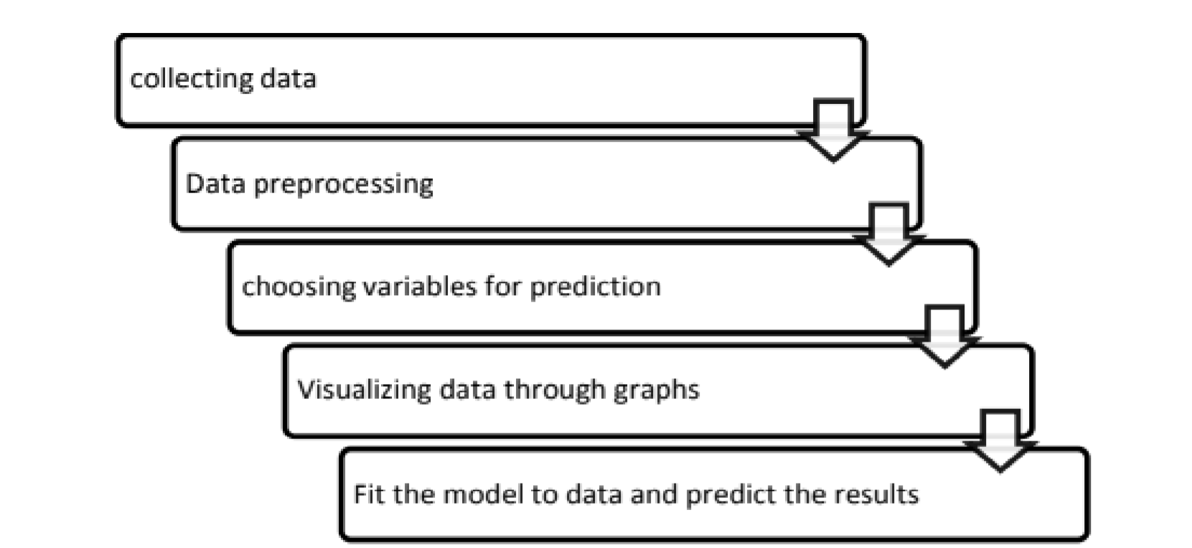
Approach and Design
The below figure explains the approach we have taken into building the predictive model using machine learning algorithms.

Slide 6
ALGORITHMS
After the feature selection and splitting the train and test data, we use three different algorithm to select the best one.
Algorithms Used
Decision Tree Regression
Linear Regression
Support Vector Machine

Slide 7
DECISION TREE REGRESSION
Decision tree builds regression or classification models in the form of a tree structure. It breaks down a dataset into smaller and smaller subsets while at the same time an associated decision tree is incrementally developed. The final result is a tree with decision nodes and leaf nodes.
The Decision tree is used to fit a sine curve with addition noisy observation. As a result, it learns local linear regressions approximating the sine curve.
In decision analysis, a decision tree can be used to visually and explicitly represent decisions and decision making. Based on the fitting data we are going to calculate the accuracy and error in the model.

Slide 8
LINEAR REGRESSION
linear regression is a linear approach for modelling the relationship between a scalar response and one or more explanatory variables.
We are going to choose the dependent variable and predict the accuracy and error in the model.
Linear Regression is the process of finding a line that best fits the data points available on the plot, so that we can use it to predict output values for inputs that are not present in the data set we have, with the belief that those outputs would fall on the line.

Slide 9
SUPPORT VECTOR MACHINE
Support Vector Machine or SVM is one of the most popular Supervised Learning algorithms, which is used for Classification as well as Regression problems.
The objective of the support vector machine algorithm is to find a hyperplane in an N-dimensional space (N — the number of features) that distinctly classifies the data points.
Support vector machine is another simple algorithm that is highly preferred by many as it produces significant accuracy with less computation power.

Slide 10
Result
Decision Tree Regression - Model Evaluation
Mean Absolute Error (MAE): 3.9665918723510347
Mean Squared Error (MSE): 122.64298180004987
Root Mean Squared Error (RMSE): 11.0744291861951
Linear Regression - Model Evaluation
Mean Absolute Error (MAE): 13.095521348645773
Mean Squared Error (MSE): 301.4403800998092
Root Mean Squared Error (RMSE): 17.36203847766181
Support Vector Regression - Model Evaluation
Mean Absolute Error (MAE): 14.689273833142883
Mean Squared Error (MSE): 376.2689686154565
Root Mean Squared Error (RMSE): 19.39765368840924

Slide 11


